Slide 1
Master Theorom

Slide 2

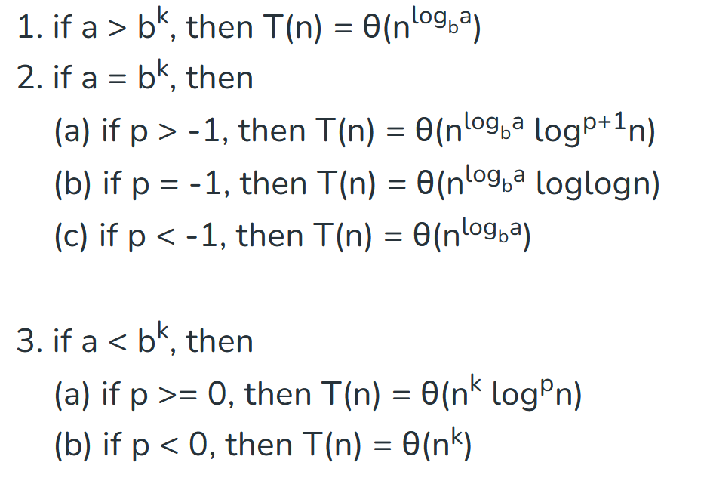
a>=1 , b> 1, k>=0, p is real number

Slide 3
T(n) = T(n/2) + 1

Slide 4
T(n) = 2T(n/2) + n

Slide 5
T(n) = 2T(n/2) + nlogn

Slide 6
T(n) = 2T(n/2) + n/logn

Slide 7
T(n) = 3T(n/2) + n²

Slide 8
T(n) = 2T(n/2) + n^{0.51}

Slide 9
T(n) = 0.5T(n/2) + 1/n

Slide 10
T(n) = 3T(n/2) + log²n

Slide 11
T(n) = 2T(n/2) + nlog²n

Slide 12
T(n)= 16 T(n/4) + n

Slide 13
T(n) = 2^{n}T(n/2) + n^{n}

Slide 14
Little oh
The "little-oh" notation, is a mathematical notation used in the analysis of algorithms and functions to describe their growth rates or behavior as their input approaches infinity.
Formally, for a function g(n), we say that f(n) is o(g(n) if, for any positive constant c>0, there exists a constant n0​ such that for all n greater than n0​, the absolute value of f(n) is always less than c times the absolute value of g(n).
In simpler terms, f(n) grows much slower than g(n) as n approaches infinity.
f(n)=n g(n)=n*n f(n)=logn g(n)=n

Slide 15
Little omega
It represents a lower bound that is not tight.
Formally, for a function g(n), we say that f(n) is ω(g(n)) if, for any positive constant c>0, there exists a constant n0​ such that for all n greater than n0​, the absolute value of f(n) is always greater than c times the absolute value of g(n).
In simpler terms, f(n)f(n) grows much faster than g(n)g(n) as nn approaches infinity.

Slide 16
Space complexity
Space complexity is a measure of the amount of memory or storage space an algorithm or program uses to solve a problem as a function of the size of the input.
It is often expressed in big O notation.

Slide 17
Space complexity of various sorting algorithms
Bubble sort: O(1)
Selection sort: O(1)
Insertion sort : O(1)
Merge sort : O(n)
Quick sort: O(n)
Heap sort: O(1)
Counting sort: O(K)
Radix sort : O(n+k)

